Slide 1

Health Launchpad
Summer Project
Pearson T Level Technical Qualification in Health

Slide 2

Welcome to T Level Health
Your journey into professional healthcare starts today.

Slide 3
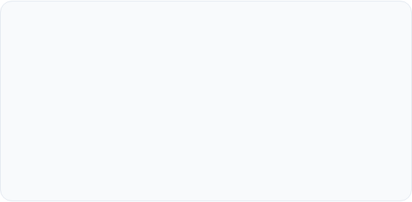
THE SUMMER PROJECT FOCUS
Busting the Myth
IDocumentation
Healthcare is far more than just following orders. It's about critical thinking, clinical observation, and becoming a fierce patient advocate.
You can use a variety of sources to build your professional clinical eye before you step through our doors in September.

Slide 4

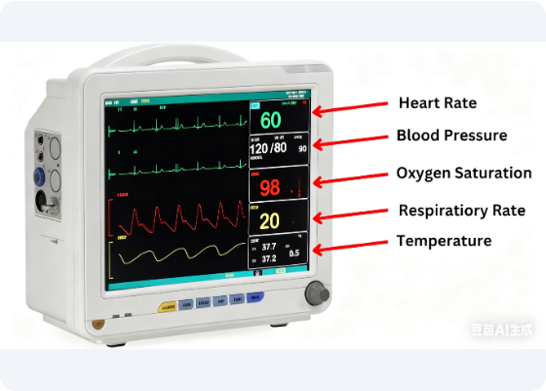
WEEK 1: THE CLINICAL EYE
Professional healthcare workers don't just see a patient; they register vital signs, safety hazards, and emotional cues in seconds.
This week, you'll put on your professional hat to train your detailed clinical observation skills through immersive scenarios.

Slide 5
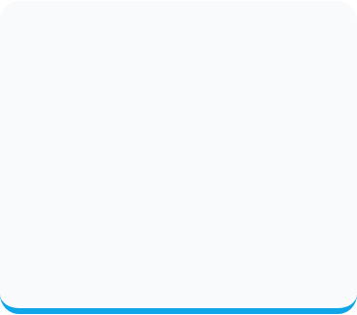
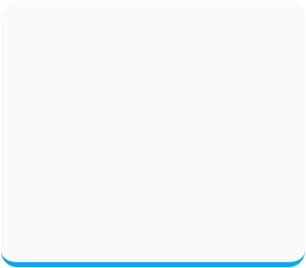
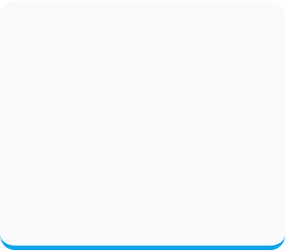



FIRST IMPRESSION CHALLENGE
Observation
Pathway
Reflection
Decide which specialism (Nursing, Midwifery, Mental Health) excites you most. Produce a poster to explain the role
Write a reflection on the professional skill you have identified and how this can impact patient care
Identify one professional skill practiced by the clinician in the scenario.

Slide 6

WEEK 2: CARE & DIGNITY
The 6 Cs Pillar
Care and Compassion are the backbone of the NHS. Establishing trust is just as vital as clinical intervention. Treating a patient with dignity is not just manners—it is clinical safety.

Slide 7



THE EMPATHY CHALLENGE
Reassurance
Active Listening
Patient Safety
What specific action can help a terrified new patient feel safe?
Evaluate the impact of taking an extra 30 seconds to truly listen.
How does empathy reduces clinical errors and helps healing pathways.

Slide 8

WEEK 3: COMMUNICATION
Professional Interaction
Clinical communication involves verbal precision, non-verbal cues, and active listening. In medical settings, it is the key to preventing errors.
Mastering gestures and tone builds rapport and ensures patient safety in fast-paced clinical environments.

Slide 9
COMMUNICATION PILLARS
Body Language
MDT Coordination
Sitting at eye level, using open posture, and maintaining appropriate contact are vital non-verbal tools.
Why Multi-Disciplinary Team (MDT) communication is just as critical as nurse-to-patient interactions.

Slide 10
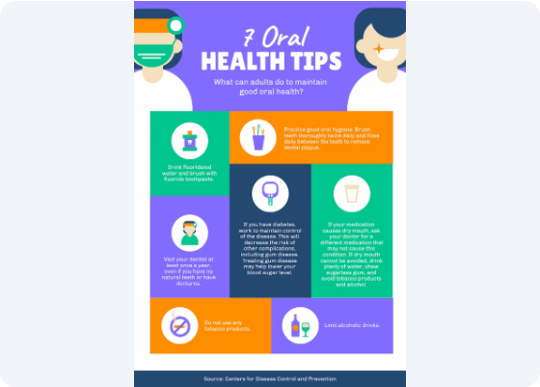
WEEK 4: HEALTH PROMOTION
Healthcare professionals are educators. Your job is to treat the sick AND teach the community how to stay healthy.
Translating complex clinical data into simple wellness messages is a core part of the T Level curriculum.

Slide 11



CREATIVE MAKER CHALLENGE
Hydration Hero
Hygiene Guide
Nutrition Check
Design a graphic reminding patients why drinking 8 glasses of water matters.
Create a simple 5-step visual guide to stop clinical infections.
Expose hidden sugars in everyday snacks to promote healthier choices.

Slide 12
Next Steps
Complete your booklet and bring your creations to Induction Week.
T Level Health Department | Pearson Vocational Lead

